Slide 1
OS 2 – Project 1
The Sleeping Teaching Assistant

Slide 2
Project Members
-أحمد ابوبكر أحمد الزمر 20210019
-يوسف مصطفى غانم عبدالعزيز 20211111
-حسن محمد حسن عبدالحميد 20210292
-يوسف مصطفى محمد سليم 20211112
-محمود علي محمود احمد 20210871
-احمد ابراهيم اسماعيل محمد 20210015

Slide 3
Project Description
Project 1: The Sleeping Teaching Assistant :
Write a program The TA helps students with their programming assignments during regular office hours, and their office has only one desk with a chair and computer. The hallway outside the office has three chairs where students can sit and wait if the TA is currently helping another student. If the TA is not assisting any students during office hours, they take a nap.

Slide 4
Project Goal
-The goal of this project is to implement a solution that coordinates the activities of the TA and the students using Java threads, mutex locks, and semaphores. The system should handle the TA's behavior when helping students, taking naps, and the behavior of students arriving at the TA's office during office hours.

Slide 5
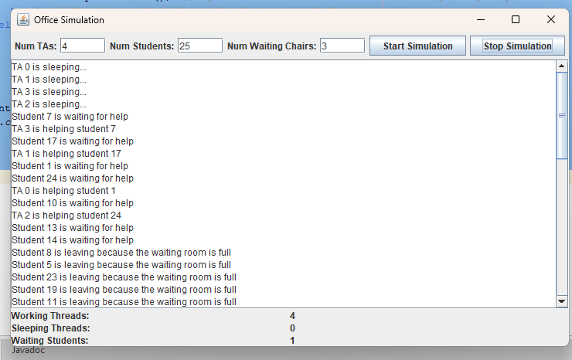
The Sleeping Teaching Assistant simulation
Lists out all files (Includes subdirs if needed).
Analyses each file in the chosen directory.
Gets the longest, shortest words among all files.
Output is in real-time.

Slide 6
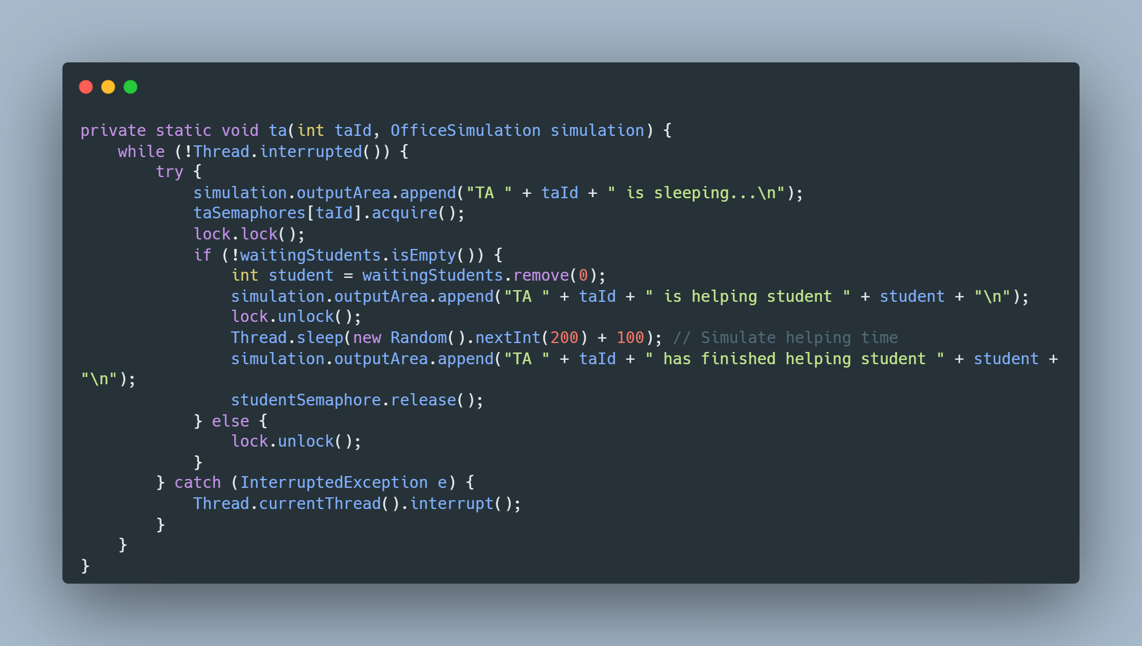
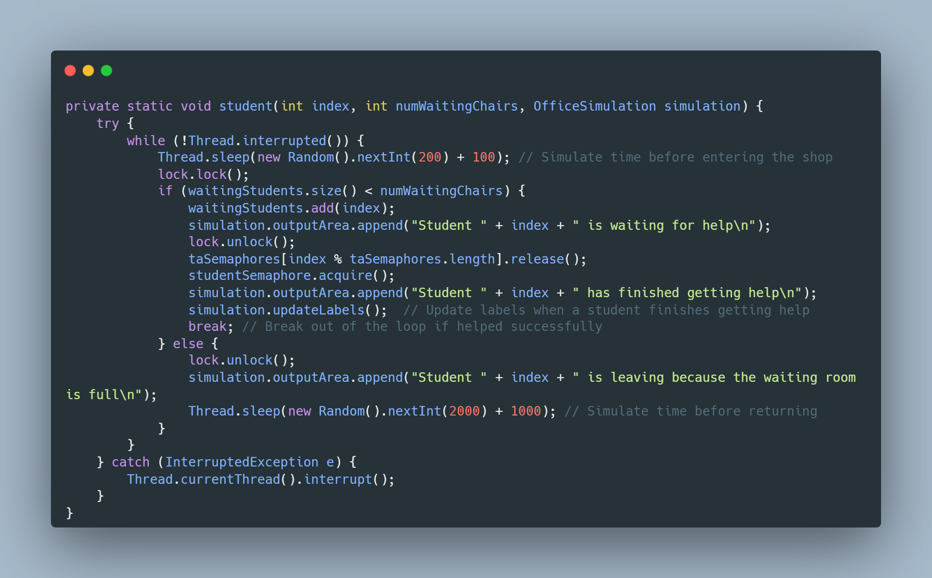
Mutex locks
The mutex semaphore is initialized with a single permit, acting as a mutex (mutual exclusion lock).
It is used to ensure that critical sections of code are executed by only one thread at a time.
ReentrantLock (Lock):
The lock (a ReentrantLock) is used for synchronization to provide fine-grained control over critical sections.
It is used in conjunction with the lock.lock() and lock.unlock() methods.
Mutex and Lock Usage:
In the ta and student methods, the mutex (mutex) and lock (lock) are used to ensure that access to the shared resource (waitingStudents list) is synchronized.
The critical sections where shared resources are accessed are protected by acquiring and releasing the mutex or lock.

Slide 7
TA Thread Logic
Represents the behavior of Teaching Assistant (TA) threads in the simulation.
Lock the mutex to ensure exclusive access to shared resources lock.lock();
TAs wait for students and help them in a first-come-first-served order.
Unlock the mutex since the critical section is complete lock.unlock();
Uses a semaphore (mutex) to ensure mutual exclusion when accessing shared resources.

Slide 8
Student Thread Logic
*Represents the behavior of Student threads in the simulation.
* Students arrive, wait in a waiting room, and leave if the room is full.
* Uses a semaphore (mutex) to ensure mutual exclusion when accessing shared resources.

Slide 9
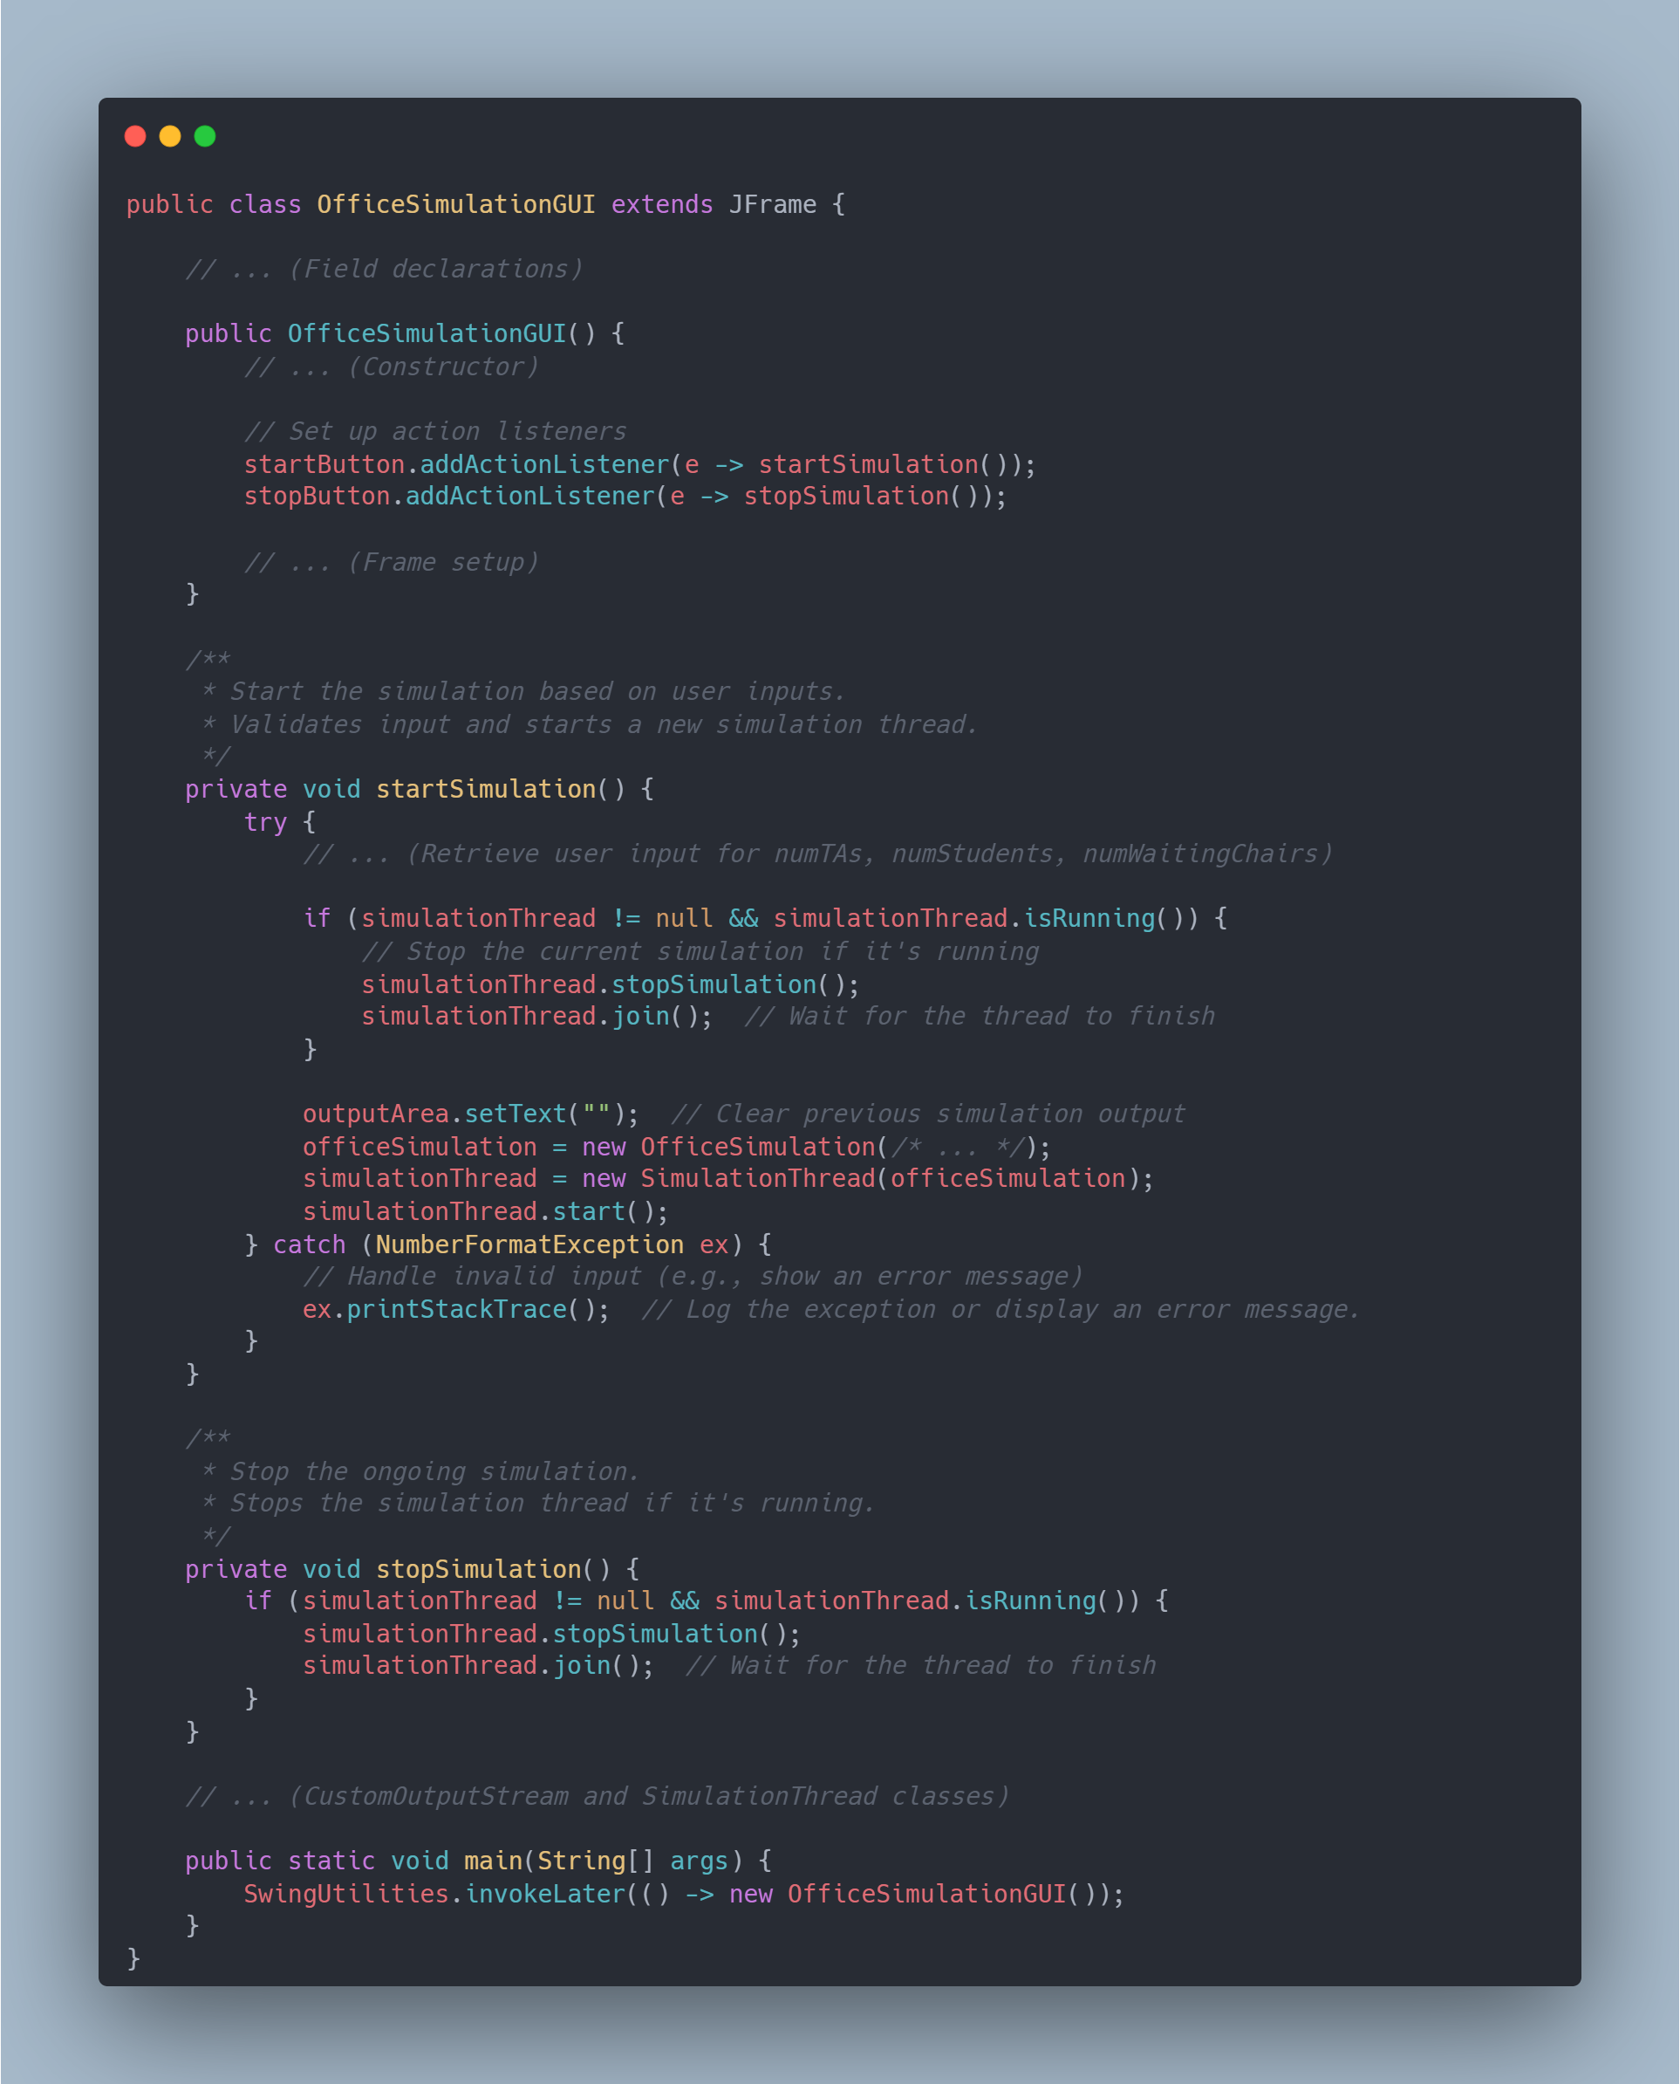
The Sleeping Teaching Assistant simulation GUI
Graphical User Interface for The Sleeping Teaching Assistant simulation
* This GUI provides a user interface for configuring and visualizing the simulation of a university office
.
* It uses Swing components to display output logs, labels, and buttons to start/stop the simulation.
* The simulation is redirected to a JTextArea, and thread updates are visualized through labels.
This is a snippet from the main GUI class for the application.
Sets up buttons, checkbox, Jtable, Selected directory Path, etc…
Once startProcessing button is pressed, processDirectory() occurs.

Slide 10


